Slide 1










CMT216
Digital Forensics
  Michael Daley

Slide 2
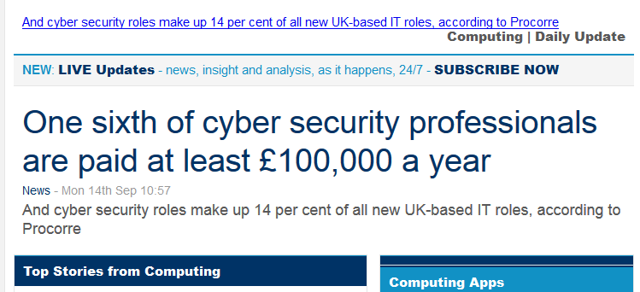

Slide 3
INTRODUCTION
This module aims to be very much hands on.
During this module you will learn the fundamental workings of a computer system at a very low level.
You will be required to do real analysis on images provided
You should spend time reading the course material and suggested books.
During the module you will be shown how to use the Open source tools and also get some hands on experience of using the two main commercial tools used in the UK.

Slide 4
CODE of ETHICS
During this course you will be introduced to tools and programs that could potentially be used to “HACK” into systems.
In addition the knowledge gained could also be used in system hacking.
You are therefore required to sign a form that states that the information, programs and tools you receive will only be used in an ethical, professional and legal manner.

Slide 5
COURSE OVERVIEW
12 Weeks 9.00 am until 12-30 pm
PLEASE NOTE:
    We have a lot to get through so a prompt start would be appreciated.

Slide 6
COURSE OVERVIEW
Forensic Foundations
    Computer forensics primer
    Forensic investigation methodology
    File system essentials
      FAT File System, NTFS
Forensic Methodology
    Forensic incident response and volatile evidence gathering
    Hard drive evidence acquisition
    File system forensic analysis
    Automated toolkits (Autopsy, FTK and Blacklight)

Slide 7
COURSE OVERVIEW con’t
Windows Forensics
    Windows imaging
    Windows volatile evidence acquisition
    Windows media and Artifact Analysis
    Memory Analysis and malware artifacts.
Steganography
Mobile Phone Forensics
    SIM cards
    Handsets and Memory Cards
Legal issues. Final review.
    Legal basics
    Who can investigate
    Data collection
    Data analysis and report writing
    Data preservation and presentation in court

Slide 8
Pt2 Network Forensics
Why do network forensics? (Differences between Network and Digital Forensics)
Network protocol overview
Network evidence types and sources
Network data acquisition
Netflow analysis, visualisation

Slide 9
Course Assessment
TWO pieces of coursework
  A digital forensic assignment consisting of a compromised image that you are provided with. You then need to analyse the image for evidence and produce a Technical report and a Court Report. WORTH 20%
  A shorter assignment analysing network capture data and extracting evidence from the capture. You will be required to provide a technical report showing how you went about your analysis. WORTH 10%
EXAM
  2 Hour exam, covering both digital and network forensics. WORTH 70%

Slide 10
Background
Useful background information.
  Understanding of LINUX command Line
  Use of Virtual Machines (Vmware)
  Basic networking (TCP/UDP and HTTP protocols)

Slide 11
Useful web sites
www.forensicfocus.com
www.msab.com
www.cellebrite.com
www.sans.org
www.nationalcrimeagency.gov.uk
www.blackbagtech.com

Slide 12
What is Digital forensics?
First off. What is Forensics?
  Defined as, “the use of science and technology to investigate and establish facts in criminal and civil courts of law”
Digital Forensics
  Considered to be, “the use of analytical and investigative techniques to identify, collect, examine and preserve evidence/information which is magnetically stored or encoded”

Slide 13

Digital forensics is NOT:

Slide 14
Digital forensics is NOT:
Pro-active (security)
  It is reactive to an event or request
About finding the bad guy
  It is about finding evidence of value
Something you do for fun
  Proper forensic investigations require expertise
Quick
  Multi TeraByte drives are becoming available.
  Lets look at what this means.

Slide 15
8 bits = 1 byte
One byte = 1 character
A

Slide 16
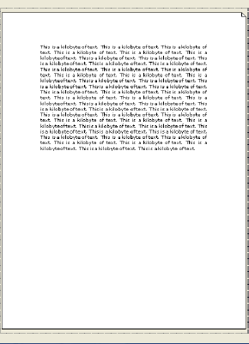
1 kilobyte = 1024 characters
About ½ a page of A4

Slide 17

1 megabyte = 1 million characters or
500 sheets of A4 paper (about 5 cm thick)
<5cm>

Slide 18
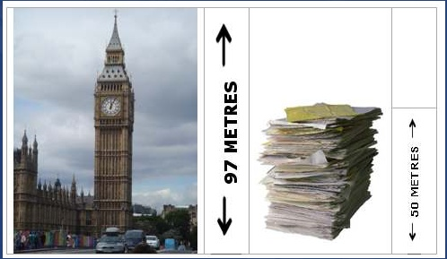
1 gigabyte = 1 billion characters or a pile of paper 50 metres tall (1000 packs of A4)

Slide 19

1 Terabyte is about average hard drive size at the moment.
That’s just under 40 km of paper
Or approx height of 4 Mount Everests
+
+
+
=
Notes:
8,848 m

Slide 20
The 4 terabyte drives are now becoming common.
That’s
4 trillion characters.
Or 4 million packets of A4 paper which if put end to end would reach………

Slide 21
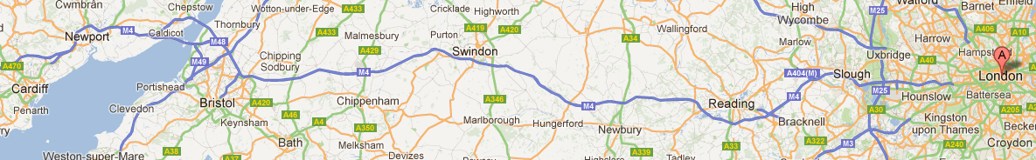
….about 200 kilometers
Approx Cardiff to London stacked along the M4

Slide 22
An average person can read and process about 220 words per min….
Which is about a kilobyte of data (1/2 an A4 page)

Slide 23
So doing the calculation….
Reading two terabytes of data would take the average person.
2 x 1000 x 1000 x 1000 minutes
Or
33,333,333 hours
Or
1,388,888 days

Slide 24
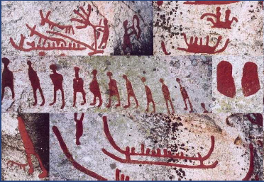
Or 3805 years
The Nordic Bronze age started 3800 years ago

Slide 25


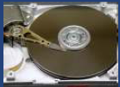
14Tb 3.5” drives are now available (£515.48 2019)
6Tb 3.5” drives are now available for around £140
14 Tb is approx. 560km of paper.
You could get the whole of the British Library’s current digital media onto two 6Tb drives. But is growing by 12km per year. However, On Friday, 5 April 2013, the Library announced that it would begin saving all sites with the suffix .uk (every British website, e-book, online newsletter, and blog) in a bid to preserve the nation's "digital memory" (which as of then amounted to about 4.8 million sites containing 1 billion web pages). plans to archive the web means a calculated 100 Terabytes of data annually is required. 1 petabyte of digital content to date.
= 2x 6TB
Notes:
Samsung have announced there biggest SSD 30TB not yet released.

Slide 26
So?
ASK YOURSELF:
WHO ONLY HAS ONE DEVICE THESE DAYS ANYWAY?
Destop, Laptop, Tablets, Phones!!
A recent advert for Samsungs new smartphone Galaxy Note 9 states it comes with 500 Gig but is 1 Tbyte ready.
YOU SEE THE PROBLEM.

Slide 27
Ask yourself
If a criminal or malicious employee stole data from your organisation, would you have the skills to detect it?
Could you gather evidence that would allow you to recover losses in the courts or help the authorities prosecute a criminal case?
Can you advise management on how to protect your organisation and mitigate loss?
This module will provide a sound initial grounding for those who will investigate forensic computing incidents and provide evidence for the courts.

Slide 28
Who does Computer Forensic Analysis?
The usual answer that most people will come up with is the Police.
  In the past this was true.
However, more and more companies now realize that they need “in-house” Forensics as first response to possible, intrusion and malicious intent.
Others include:
  Military
  Government Agencies
  Law Firms
  Criminal Prosecutors
  Academia
  Data Recovery Firms
  Corporations
  Insurance companies
  Individuals

Slide 29

No matter what the computer crime, there is always incriminating evidence...
Locard's exchange principle - "a perpetrator will bring something into a crime scene and leave with something from it.”
Dr. Edmond Locard (13 December 1877 – 4 May 1966) was a pioneer in forensic science who became known as the Sherlock Holmes of France. He formulated the basic principle of forensic science as: "Every contact leaves a trace".

Slide 30
Starting your Investigation
For the technical part of the forensic process, two principles are of utmost importance.
Data integrity – electronic evidence must not be modified in any way during the forensic process, including the initial data capture.
Audit trail – a record of all actions taken when handling digital evidence must be created and preserved.

Slide 31

Data/Evidence Integrity:
Ensure that the evidence has not been altered.
Bit-image copies
Locked and limited access cabinet for originals.
Fully documented record of who has had access to the evidence and why.
Use cryptographic hashes to ensure integrity of original evidence and copies.

Slide 32
Evidence
To make a judgement a court of law has to rely on ‘evidence’ presented to it.
Evidence is any of the material items or assertions of fact that may be submitted to a competent tribunal as a means of ascertaining the truth of any alleged matter of fact under investigation before it.
Ref: Encyclopedia Britannica – http://www.britannica.com/EBchecked/topic/197308/evidence

Slide 33
Evidence con’t
Traditionally evidence was gathered in physical form. After the invention of photography it became common practice to take photographs at the crime scene and present the photographs along with other evidence.
With the digital revolution and following usage of electronic devices in almost all aspects of life it became necessary to allow evidence extracted from electronic devices, especially with electronic storage capacity, for use in judicial proceedings.
We call such evidence ‘electronic evidence’.

Slide 34
Evidence con’t
In modern judicial practice electronic evidence is no different from traditional evidence, so it is mandatory that the party introducing it into legal proceedings is able to demonstrate the evidence was left intact from the moment it was collected – including the collecting process.

Slide 35
Evidence con’t
It must be stressed that electronic evidence, being usually much easier to manipulate than traditional forms of data, requires a great care when handled to be admissible in a court of law.
The seizure, custody, control, transfer, analysis and disposition of the evidence must be chronologically documented in a proper way constituting a ‘Chain of custody’ (CoC).

Slide 36
AUDIT TRAIL : Chain of Custody (CoC)
It must be stressed that electronic evidence, being usually much easier to manipulate than traditional forms of data, requires great care when handled, if it is to be admissible in a court of law.
The seizure, custody, control, transfer, analysis and disposition of the evidence must be chronologically documented in a proper way constituting a ‘Chain of custody’ (CoC).
The main purpose of a Chain of Custody is to provide a proof to the court, that at no point in time the evidence could had been tampered with.

Slide 37
Evidence Integrity: CHAIN of CUSTODY
Ensure that the evidence has not been altered.
Bit-image copies
Locked and limited access cabinet for originals.
Fully documented record of who has had access to the evidence and why.
Use cryptographic hashes to ensure integrity of original evidence and copies.
Wikipedia – https://en.wikipedia.org/wiki/Chain_of_custody

Slide 38
Preserving Evidence Using a Write-Blocker
Always use a write-blocking hardware device or write-blocking software when acquiring digital evidence!
We will look at how we do this in our practical session.

Slide 39
General guidelines
Proper handling of any evidence, including electronic evidence, requires following some general guidelines:
In the UK we generally follow the Association of Chief Police Officers (ACPO) guidelines.
The following slide shows the 4 basic principles that we need to adhere to.

Slide 40
Four principles are involved:
Principle 1: No action taken by law enforcement agencies or their agents should change data held on a computer or storage media which may subsequently be relied upon in court.
Principle 2: In exceptional circumstances, where a person finds it necessary to access original data held on a computer or on storage media, that person must be competent to do so and be able to give evidence explaining the relevance and the implications of their actions.
Principle 3: An audit trail or other record of all processes applied to computer based electronic evidence should be created and preserved. An independent third party should be able to examine those processes and achieve the same result.
Principle 4: The person in charge of the investigation (the case officer) has overall responsibility for ensuring that the law and these principles are adhered to.

Slide 41


When investigating a digital crime scene we are faced with two possible scenarios:
  Live System
    Power is still on.
    Processes still running
    Disks being accessed
    Removable media changing
Dead System
  Power unplugged
  Computer system off
  Hard Drive
  Floppy Disks
  CD-ROM's, USB sticks

Slide 42
Investigation process – put simply
Observe and evaluate environment
  “If it is on, leave it on – if it is off, leave it off.”
Gather and safeguard evidence
Maintain a clear chain of custody
Perform an evidentiary evaluation
Document findings
Provide expert testimony as required

Slide 43
Some unique characteristics of digital evidence:
It’s invisible to the untrained eye.
Electronic evidence is often retrieved from places known or accessible only to experts.
It may need to be interpreted by a specialist.
In many cases information gained requires thorough analysis to uncover properties assuring the information is valid from judicial point of view.
It’s highly volatile.
A powered electronic device modifies its state every time a specific event happens. Lack of power or a system overwriting old data with new data requires us to preserve electronic evidence as soon as possible.
It may be altered or destroyed through normal use.
Devices constantly change the state of memory – allocating it for programs automatically, swapping it to disk or writing chunks of it to a disk file on user request. This characteristic calls for using appropriate tools and techniques from the very moment of identification the evidence as relevant for an investigation.
It can be copied without limits.
This property allows many specialists work on the same evidence at the same time in different places. It also enables the possibility of presenting the evidence as-is in the court of law along with the specialist witness report.

Slide 44
So who uses digital evidence ? (1/3)
Many types of criminal and civil proceedings can and do make use of evidence revealed by computer forensics specialists:
  Criminal justice agencies
  Crown Prosecution (UK), Solicitor, barristers and Judges
  Corporate Councils
  Company Legal resources
  Human Resources department
  Auditors
  Individuals
  Crackers/Hackers

Slide 45
Who uses digital evidence ? (2/3)
Criminal Prosecutors use computer evidence in a variety of crimes where incriminating documents can be found:
  murders, financial fraud, drug and embezzlement recordkeeping, and child pornography.
Civil litigations can readily make use of personal and business records found on computer systems that bear on:
  fraud, divorce, discrimination, and harassment cases.
Insurance Companies may be able to mitigate costs by using discovered computer evidence of possible fraud in
  accident, arson, and workman's compensation cases.

Slide 46
Who uses digital evidence ? (3/3)
Corporations often hire computer forensics specialists to ascertain evidence relating to:
  Sexual harassment, embezzlement, theft or misappropriation of trade secrets and other internal/confidential information.
Law Enforcement Officials frequently require assistance in post-seizure handling of the computer equipment.
Individuals sometimes hire computer forensics specialists in support of possible claims of:
  Wrongful termination, sexual harassment, or age discrimination.

Slide 47
Types of digital forensics:
Device-level investigation
Network investigation
Memory investigation
Software investigation
Steganographic investigation
Digital Imagery
Digital Sound
Digital Video
Encrypted or Embedded Content

Slide 48
The types of incident
Malicious code attacks
    Viruses, Trojan horse programs, worms and hacker scripts.
Unauthorized access.
    Improper logging into user accounts, unauthorized access to files etc.
Unauthorized utilization of services.
    an intruder may also obtain access to information or plant trojans and sniffers by misusing available services

Slide 49
The types of incident con't
Disruption of service.
    Disruption of network services, erase critical processes, spamming, denial of service.
Misuse
    Using compute services of other than official purposes.
Espionage
    stealing information to subvert the interests of a company or government.

Slide 50
The types of incident con't
Hoaxes
    False information is spread about an incident or threat e.g. The good times virus 1995 (Non existent hoax)
Pornography
    In particular Child Pornography

Slide 51
Other forms of incident:
(Interlectual Property (IP) Theft)
Why do people do it?
  Moved to competitor (70%)
  Set-up competition (23%)
What is stolen?
  Customer/client information (75%)
  Financial info (14%)
  Business Presentations (5%)
How did they do it?
  E-mail (46%)
  Hard copy (22%)
  Electronic storage device (9%)

Slide 52
Cybercrime
In the world of cybercrime the twin disciplines of computer security and digital forensics are inextricably linked, one trying to protect systems from cybercrime and the other investigating them after a cybercrime has been committed.
The growth of cybercrime over the last decade has been well documented in the UK. In the most recent survey for the year ending in March 2018, the Office of National Statistics estimates that around 4.5 million cybercrimes were committed in England and Wales during that twelve month period.
Of those, around 3.24 million were fraud offences, with around £130 billion being stolen, and about 1.23 million were related to computer misuse (encompassing child pornography and hacking).
In the past the UK has struggled to establish a cybercrime strategy since the National Hi-Tech Crime Unit was amalgamated into the Serious and Organised Crime Agency back in April 2006.
However, the UK has now setup the National Crime Agency

Slide 53
NCA
The NCA is a new crime-fighting agency with national and international reach and the mandate and powers to work in partnership with other law enforcement organisations to bring the full weight of the law to bear in cutting serious and organised crime.
http://www.nationalcrimeagency.gov.uk/

Slide 54
Definition
“Computer forensics is the application of computer investigation and analysis techniques in the interests of determining potential legal evidence”

Slide 55

Forensic Principles
Four Forensic Principles = SUCCESS
    Record everything.
    Minimise data loss.
    Analyze all data collected.
    Report your findings.

Slide 56
Principles of Incident Response
  Verify incident has occurred
  Gather evidence but ensure:
  Preservation of evidence, minimal data and evidence loss
  Avoid adding data to the system through your actions
  Containment and recovery.
  Determination of damage
  Report documentation

Slide 57
Three Major steps
Incident response and Evidence Acquisition
Investigation and Analysis
Reporting the results

Slide 58
Investigation and Analysis
Media Analysis
  Focuses on processing copies of evidence gathered at the scene of the incident. (i.e. an image)‏
  Is not considered evidence gathering, but evidence analysis
  Primarily used to find specific data pertaining to the crime
  Uses Forensic Workstations and automated tools to parse through gigabytes of data

Slide 59
Reporting the Results
Key considerations
    Clarity
    Accuracy
Style and tone
    Professional
    No slang, prejudice or bias
    No unsupported opinions
Apply scientific method
Consider audience, including a court

Slide 60
Where is the data?
When approaching a crime scene what should we be looking for?
On the next slide how many of the items would you consider as possible places to look for evidence.

Slide 61
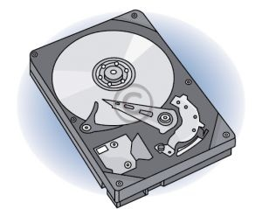

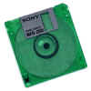
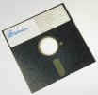


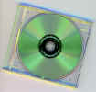

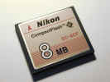


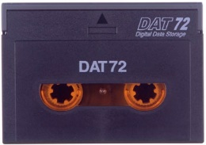









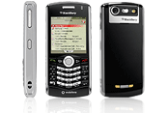


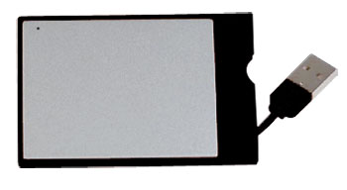

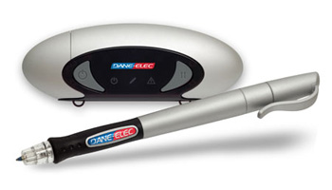
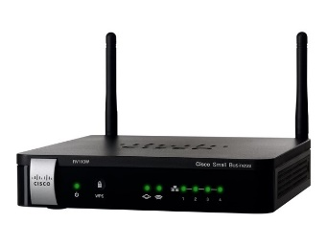


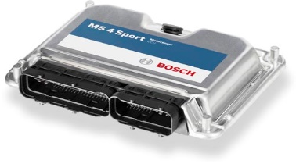
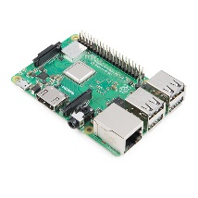
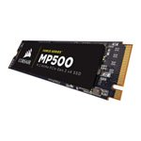



Slide 62
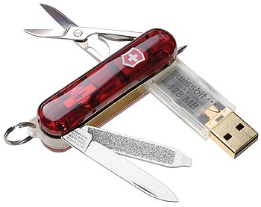

Slide 63
Digital crime scene investigation process
There are many ways of conducting an investigation. If you asked five people to investigate a potential crime scene they would each have there own way of proceeding.
So long as the results are the same and do not break any laws in the process, it does not matter which process is used, although some are more efficient then others.
In the case of computer forensics we have a digital crime scene that includes the digital environment created by software and hardware. The process of investigating this environment is in three phases.

Slide 64
Three phases of the investigation process
System Preservation
phase
Evidence searching
phase
Event reconstruction
phase

Slide 65
System Preservation
Computer evidence is very volatile.
You have to be very careful about completely understanding which evidence to gather and in what order.
You need to be aware that in some circumstances gathering one piece of evidence will accidentally modify another.
In some examples this may have to be OK as there is no way to completely take a snapshot of a running system.

Slide 66

Volatile Evidence
In order of most volatile to least:
      Memory
      Network status and connections
      Processes running
      Hard drive media
      Removable media (floppy drive, zip drive, USB sticks)‏
Destroyed if
power cut off

Slide 67
Incident response forensics
SECURE THE SCENE
Document everything you do and observe. (Photography)
Gather volatile information
    Processes and System Memory
Gather network connections
Unplug network
Verify incident
    Logs, Intrusion Detection System (IDS), interviews,system logs
Gather evidence (IMAGES)‏
Bag and Tag everything.

Slide 68











Forensic Investigation Methodology
1. Verification
Incident response
and Evidence
acquisition
5. Media
Analysis
6. String or
Byte Search
Investigation and
Analysis
7. Data
Recovery
2. System Description
4. Timeline
Analysis
8. Reporting Results
3. Evidence Acquisition

Slide 69
Verification
The first step in a forensic investigation is to verify that an incident has occurred.
This takes us through steps 1 – 4 (In previous slide)‏
We need to talk to any personnel associated with the system, i.e systems admin.
Check any logs they may have etc.
We need to secure the scene and start our investigation.

Slide 70
System Description
Document and label all evidence.
Photography/video is a good way of doing this.
Describe the system that is being analysed
Document how the system was acquired?
What is/was it used for? i.e. Laptop, Desktop PC or Server
What is its configuration (OS, network)‏
Plus any other information you find that may be relevant.

Slide 71
Evidence Acquisition
Obtain volatile data
    Memory
    Network connections
    Processes
Obtain pertinent data
Obtain a forensic image
Start to build your “dirty word“ list
Shutting down the computer(s).

Slide 72
Timeline
You usually have a window of time in which the incident occurred.
Perform a file timeline analysis
    Modified, accessed, created/changed time
    Highlight when the operating system was installed
    When were major updates performed?
    When was it used last?
Include any other interesting details that could be discerned based on the use of the system.
Timeline is usually the bedrock of your investigation.

Slide 73
Media Analysis
It is rare that you would analyze a live machine at this point. You should now be working with copies of the original image.
Examine the resulting image using forensic tools of your choice.
Describe the analysis system in detail.
Describe each tool used to examine the system and why you used it.
Show how your tools did not modify the evidence when performing your examination.

Slide 74
Media Analysis Examples
Examine file system for modification to OS software or configuration.
Examine file system for backdoors, check for setuid* and setgid* files on a LINUX system.
Examine file system for any sniffer programs.
Internet history file and other history files
System registry or /proc examination
Show start-up files and processes.
setuid and setgid (short for set user ID upon execution and set group ID upon execution, respectively) are Unix access rights flags that allow users to run an executable with the permissions of the executable's owner or group. They are often used to allow users on a computer system to run programs with temporarily elevated privileges in order to perform a specific task.

Slide 75
String/Keyword searches
Conduct a string search on the media.
What keywords would you look for?
Why would you look for those keywords?
Using your dirty word list, examine your evidence at a low level (bit by bit)‏

Slide 76
Data Recovery
Recover files or data deleted or in slack from the system.
Identify when the files were deleted.
Recover pertinent files.
Describe methods in detail in your report.

Slide 77
Reporting
Based on your analysis, what information could be gathered as to the habits of the subject?
    Evidence that supports the claim?
    Evidence that rejects the claim?
Findings and conclusions written
    Could be used in a court.
    Scrutinized by opposing counsel

Slide 78
Having looked at an overview of the problem lets now start to look at the detail.
We need to understand the underlying architecture of the media we are analyzing and the various file structures.
We will start by looking at the structure of a hard drive and then the various file systems that you will come across.

